Slide 1


JSS ACADEMY OF TECHNICAL EDUCATION - BENGALURU
Department of
Information Science and Engineering
Anomaly detection in Parkinson's disease using unsupervised machine learning Approach
Presented By
Abhay PJ (1JS18IS001)
Manoj GH (1JS18IS048)
Hemanth Kumar A (IJS19IS406)
Jeevan KV (1JS18IS039)
Under the guidance of
Dr. Malini M Patil
Associate. Professor, Dept. of ISE
JSSATE, Bengaluru

Slide 2
Contents
Introduction
Literature survey
Requirements specifications
Hardware specification
Software specification
Methodology
System Design
Work done in Phase I
Work to be done in phase II
References

Slide 3
Introduction
Outlier Mining : Outliers are extreme values that deviate from other observations on data , they may indicate a variability in a measurement, experimental errors or a novelty. In other words, an outlier is an observation that diverges from an overall pattern on a sample. Outlier detection in high-dimensional datasets is a fundamental and challenging problem across disciplines that has also practical implications, as removing outliers from the training set improves the performance of machine.
Types of outliers : Outliers can be of two kinds: univariate and multivariate.
Univariate : The analysis of univariate data is thus the simplest form of analysis since the information deals with only one quantity that changes. It does not deal with causes or relationships and the main purpose of the analysis is to describe the data and find patterns that exist within it. The example of a univariate data can be height.
Multivariate :When the data involves three or more variables, it is categorized under multivariate.
Example: when you change the length of triangle is changed breadth, width and area of triangle changes correspondingly.

Slide 4
Parkinson’s Disease
Parkinson's Disease: Parkinson's disease is a brain disorder that leads to shaking, stiffness, and difficulty with walking, balance, and coordination. Parkinson's symptoms usually begin gradually and get worse over time. As the disease progresses, people may have difficulty walking and talking. They may also have mental and behavioral changes, sleep problems, depression, memory difficulties, and fatigue
Why Parkinson Disease?
No specific test exists to diagnose Parkinson's disease. Doctors trained in nervous system conditions will diagnose Parkinson's disease based on your medical history, a review of your signs and symptoms, and a neurological and physical examination. The guarantee of the results to be accurate are very less as the errors and undesired symptoms play significant roles.
Symptoms of Parkinson’s Disease: Parkinson's disease has four main symptoms: Tremor, Rigidity, Akinesia and Postural Instability (TRAP)

Slide 5
Literature survey
Sr. No. | Title/Year | Algorithm | Features of PD | Our Observation
1 | Machine Learning for the Diagnosis of Parkinson's Disease: A Review of Literature 2021 | Support Vector Machine (SVM) and variants Neural ensemble Nearest neighbors and variants Regression Decision Naïve Bayes and Discriminant analysis. | Voice Gait Handwriting MRI SPECT PET | Diagnosis of Parkinson’s disease (PD) is commonly based on medical observations and assessment of clinical signs, including the characterization of a variety of motor symptoms.
2 | Machine Learning Technique Based Parkinson’s Disease Detection From Spiral And Voice Inputs 2020 | K Means Decision Tree Spiral Analysis | PPE Shimmer Voice | The patients voice dataset is analyzed using RStudio with k-means clustering and decision tree based machine learning techniques. The patients spiral drawing is analyzed using python. From these drawings principal component analysis (PCA) algorithm for feature extraction from the spiral drawings

Slide 6
Contd..
Sr. No. | Title/Year | Algorithm | Features of PD | Our Observation
3 | Lee Silverman Voice Treatment to Improve Speech in Parkinson’s Disease 2021 | STSD LSVT SPL Randomized Controlled Trials | Speech Intelligibility Effect after Treatment Sensitivity Analysis STSD during a Reading of the Rainbow and Monologues | The technique called Lee Silverman Voice Treatment (LSVT)-LOUD has previously been used to improve voice quality in people with Parkinson's disease. The objective of this study was to assess the effectiveness of an alternate intervention, LSVT-BIG (signifying big movements), to improve Functional.
4 | Early Detection of Parkinson’s Disease Using Deep Learning and Machine Learning 2019 | Random forest (RF) Logistic regression (LOGIS) Discriminant analysis (DIS) K-nearest neighbor (KNN) Support vector machines (SVM) | Rapid Eye Movement olfactory loss Cerebrospinal fluid data dopaminergic imaging markers. | Accurately detecting Parkinson's disease (PD) at an early stage is certainly indispensable for slowing down its progress and providing patients the possibility of accessing to disease-modifying therapy.

Slide 7
Contd..
Sr. No. | Title/Year | Algorithm | Features of PD | Our Observation
5 | Parkinson’s Disease Diagnosis Using Machine Learning and Voice 2018 | ANN DT RF ET GB SVM | loss of intensity monotony of pitch Loudness reduced stress inappropriate silences short rushes of speech | This paper explores the effectiveness of using supervised classification algorithms, such as deep neural networks, to accurately diagnose individuals with the disease.
6 | Machine Learning Approaches for Detecting Parkinson’s Disease from EEG Analysis 2020 | RF SVM DT LR LR LASSO | Electroencephalography (EEG) is a non-invasive technique that records the electrical activity of the pyramidal neurons of the brain, giving an indirect insight of their function with a great time resolution. | Diagnosis of Parkinson’s disease (PD) is mainly based on motor symptoms and can be supported by imaging techniques such as the single photon emission computed tomography (SPECT) or M-iodobenzyl-guanidine cardiac scintiscan (MIBG), which are expensive and not always available. In this review, we analyzed studies that used machine learning (ML)

Slide 8
Requirements specifications
Software Requirement :
Python
Google Collab
Tableau
Front-end: Django/ Flask
Hardware Requirement :
Processor: any intel or AMD processor with at least 2 cores.
RAM: minimum 2GB RAM , Storage approximately 500MB storage

Slide 9
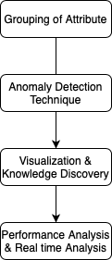
Methodology
Step 1: Data is collected, then data is cleaned to remove the error .
Step 2: The attributes are grouped to make a specific insight about the feature dependency on the target or status(like frequency,tone,shimmer,jitter)
Step 3: The datasets is processed by using various outlier detection methods like isolation forest, SVM and Z-Score.
Step 4: Visualization Tools are used to represent the knowledge gain from the outlier mining . Also it works as tool which is used to compare the algorithm.
Step 5: The performance is tested to find the accuracy of the algorithm by passing the bench dataset to real time .
Step 6: The knowledge gained is used to predict the target attribute for given input condition (Checks if given input leads to Parkinson’s diseases or not)
Figure 2. Data Flow model

Slide 10
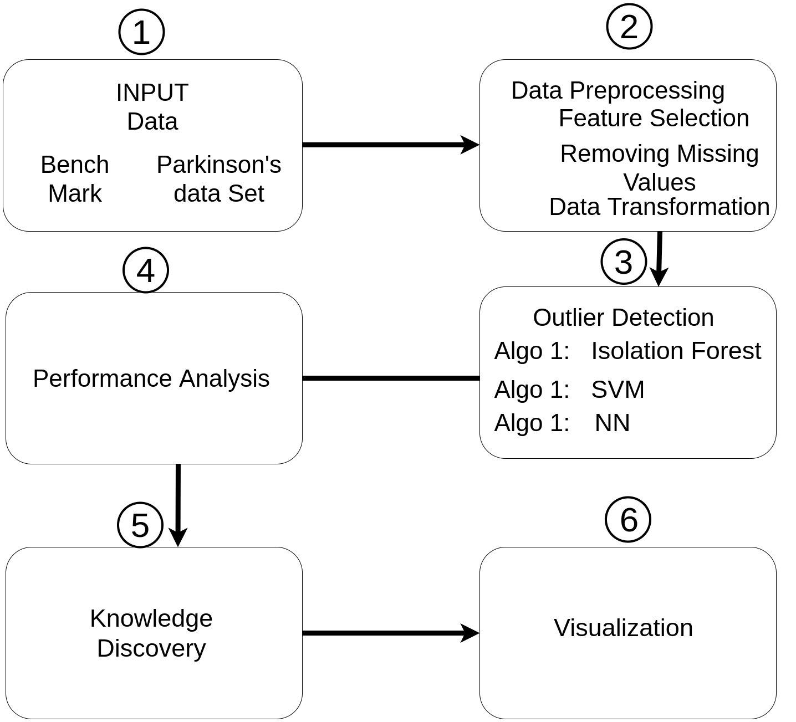
System Design
Figure 1.System Design

Slide 11
Work done in Phase I
Problem Formulation – Problem statement is constructed, Validated.
Literature Survey – Lookup for relevant research paper between 2018 to 2021. Go through the Research paper and noting down the observation on latest algorithm used on Outlier Mining.
Identification of Dataset: We have identified 2 bench dataset from the source Kaggle and UCI repository

Slide 12
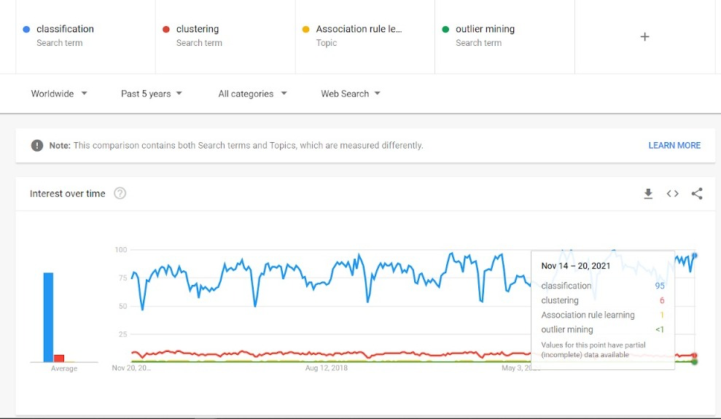
4. Identification of Gap - Very sparse Literature is available with respect to outlier technique and also in the selected domain - Health care (Parkinson’s Disease).

Slide 13
Work to be done in phase II
Particular Dataset identification- The Attributes of the bench dataset are selected, the attributes are combined to form new bench dataset.
Dataset Description – Brief description of attributes in combined dataset.
Selection of Outlier algorithm – KNN, Z-Score, Isolation Forest is implemented on the dataset and outlier are detected.
Study of algorithms – The Outliers generated after implementation is studied by checking the accuracy of model.
Implementation – We selected most optimal algorithm for our dataset and implement it on our combined dataset.
Comparison of results – The results are compared using F1-score
Preparation of implementation paper and its dissemination.

Slide 14
References
https://www.ibm.com/search?lang=en&cc=in&q=ai%20ml
http://www.aiml.foundation/
https://trends.google.com/trends/?geo=IN
https://www.mindmeister.com/?utm_source=google&utm_medium=cpc&utm_campaign=ind_en_search&utm_content=mm&gclid=
Kaur, Parmeet, 2016/12/01, 693, 696, Outlier Detection Using Kmeans and Fuzzy Min Max Neural Network in Network Data, 10.1109/CICN.2016.142
Mathew, Mevin John, and Jomon Baiju. "MACHINE LEARNING TECHNIQUE BASED PARKINSON’S DISEASE DETECTION FROM SPIRAL AND VOICE INPUTS." European Journal of Molecular & Clinical Medicine 7.4: 2020.
T. M. Thang and J. Kim, "The Anomaly Detection by Using DBSCAN Clustering with Multiple Parameters," 2011 International Conference on Information Science and Applications, 2011, pp. 1-5, doi: 10.1109/ICISA.2011.5772437
Anila M , Dr. G. Pradeepini, 2020, A Review on Parkinson’s Disease Diagnosis using Machine Learning Techniques, INTERNATIONAL JOURNAL OF ENGINEERING RESEARCH & TECHNOLOGY (IJERT) Volume 09, Issue 06 (June 2020),
Y. Ma and X. Zhao, "POD: A Parallel Outlier Detection Algorithm Using Weighted kNN," in IEEE Access, vol. 9, pp. 81765-81777, 2021, doi: 10.1109/ACCESS.2021.3085605.
Evgeniou, Theodoros, Pontil, Massimiliano, 2001/01/01, 249, 257, Support Vector Machines: Theory and Applications, 2049, 10.1007/3-540-44673-7_12

Slide 15
Thank You

